Slide 1
Week 9: Emulated Attacks

Slide 2
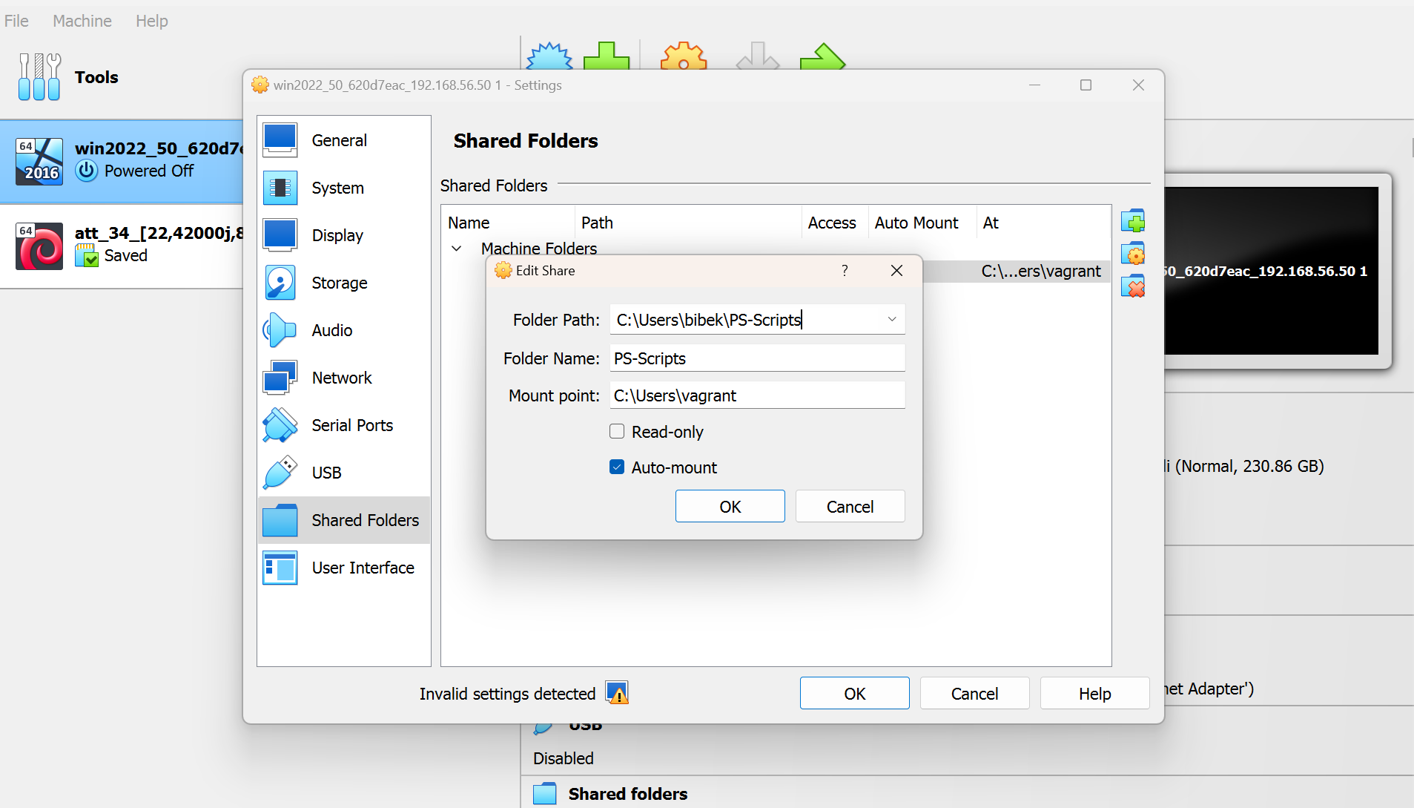
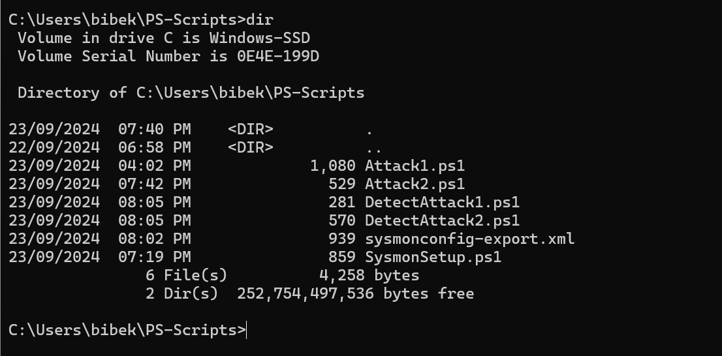
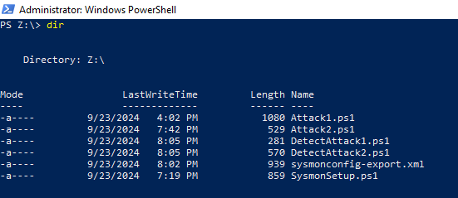
Prequisite: VirtualBox Shared Folders Setup
Before running the scripts, the Shared Folders setting must be configured in VirtualBox. This is done to create a sync between host and VM so that scripts are copied.
This will create a mounted shared folder
on the VM on the path Z:\that will copy all
the scripts that we will use later.
Demo:

Slide 3
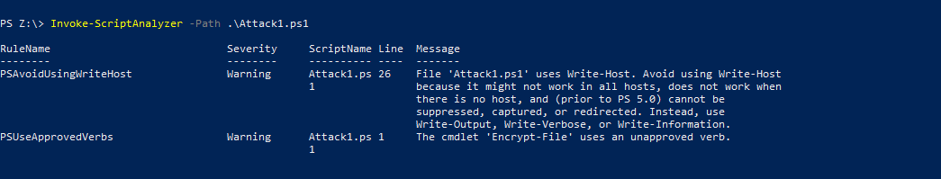
Code Documentation and Checks
Each script has been documented using comments where relevant and PSScriptAnalzyer has been used to check the cleanliness of the code at the time of writing the code.
Example Usage: PS Z:\> Invoke-ScriptAnalyzer –Path .\Attack1.ps1

Slide 4
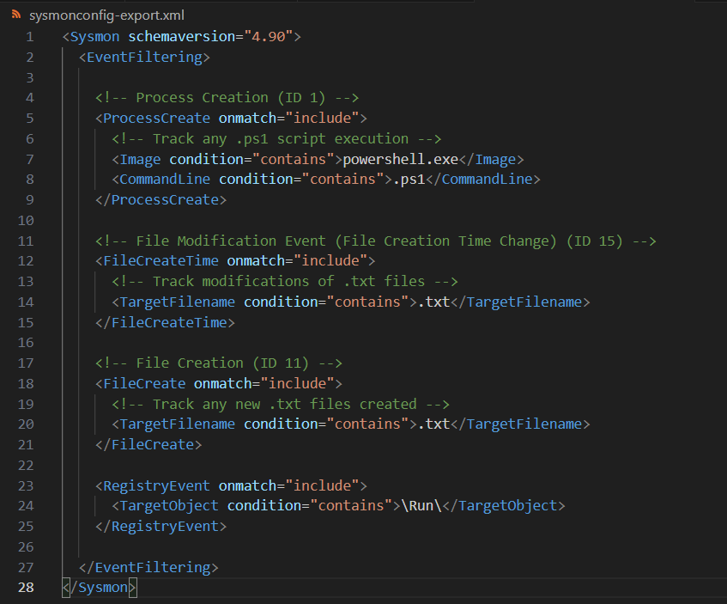
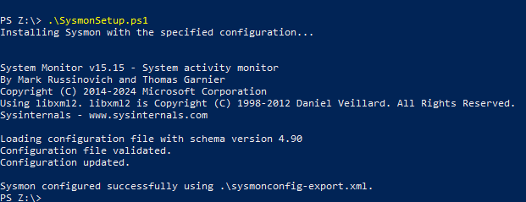
Prequisite: Setup Sysmon for Attack Detection
Custom Sysmon Config for Attack Detection
Default Sysmon configurations provide useful information, but custom rules allow us to filter and focus on specific types of events, such as file modifications and registry changes related to malware attacks.
In order to setup this up, we need to run a PS script named SysmonSetup.ps1 located in the shared folder path Z:\ that will set this custom config so that we can detect attacks type that will be emulated later. It will use a config file named sysmonconfig-export.xml
Ps command to setup Sysmon
PS Z:\> .\SysmonSetup.ps1

Slide 5
Initial Setup for Attack 1: Creating the Sample Text File for Encryption
Creation of the Sensitive File: Before encrypting the file, a simple text file containing sensitive should be created. This file represents data that would typically be targeted in ransomware attacks.
PowerShell Command to Create the File:
Ps> Set-Content -Path "$env:Temp\testfile.txt" -Value "This is a test file for AES encryption simulation. It contains sensitive information that needs to be protected."
Explanation:
This command will create a text file at $env:Temp\testfile.txt with the readable content.
Checking if the file exists by showing the contents of file: PS Command: Ps> Get-Content "$env:Temp\encrypted_file.txt"

Slide 6
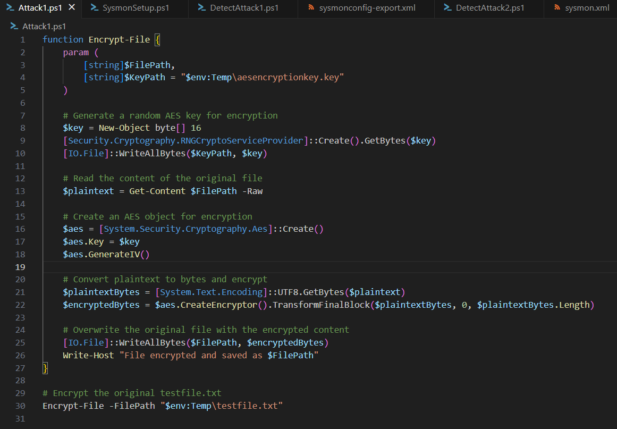

Attack 1: PowerShell Script for Emulating File Encryption Using AES
The text file created earlier is encrypted using AES encryption, rendering its content unreadable
Running the attack script:
PS Z:\> .\Attack1.ps1
Output:

Slide 7
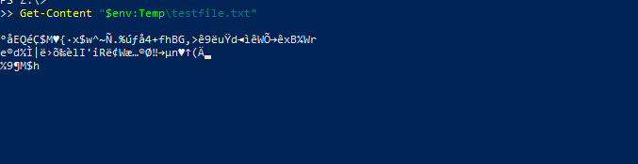
Verification of Attack 1 Impact
Before Encryption: The file testfile.txt is readable and contains sensitive data.
Command: PS> Get-Content "$env:Temp\testfile.txt"
After Encryption: The file testfile.txt contains garbled data that is unreadable.
Command: PS> Get-Content "$env:Temp\testfile.txt"

Slide 8
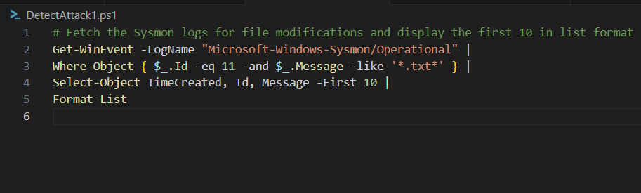
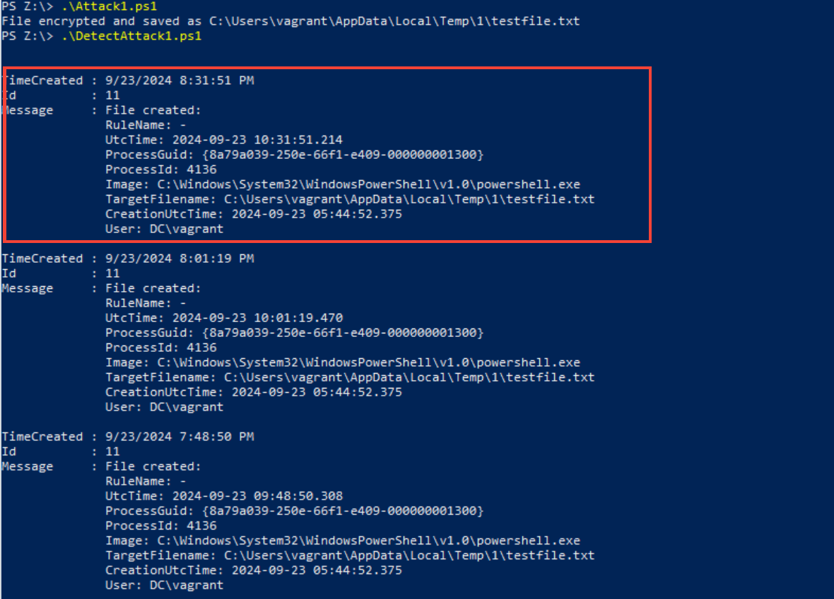
Attack 1: Detection with Sysmon
Now since Attack 1 has been emulated, we need to detect the attack using Sysmon. A PowerShell script named DetectAttack1.ps1 has been created to detect this attack. This will detect modifications to the text file using Sysmon relevant Event ID.
PS Command to Detect Attack1 PS Z:\> .\DetectAttack1.ps1
The highlighted Sysmon logs capture the file modification events during the encryption of testfile.txt. Sysmon's Event ID 11 shows:
The exact time the file was encrypted.
The process used for the encryption (PowerShell).
The user who triggered the event.
This confirms that Sysmon successfully detected the file modification as part of the simulated ransomware attack.

Slide 9
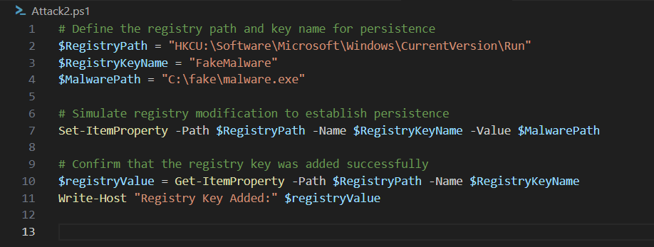
Attack 2: Simulated Registry Modification
In order to emulate this attack, a PS script named Attack2.ps1 can be executed. This script modifies the Run registry key to execute C:\fake\malware.exe each time the system starts. This simulates how real-world malware achieves persistence.
Running the attack script:
PS Z:\> .\Attack2.ps1

Slide 10
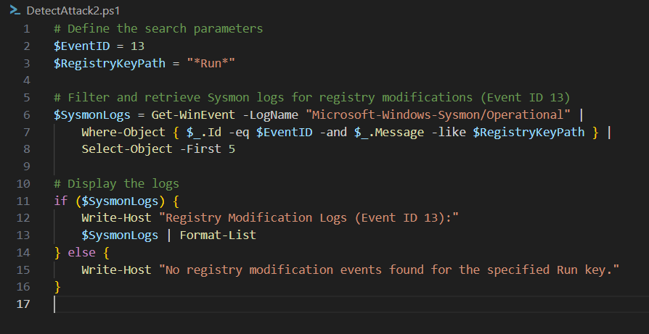
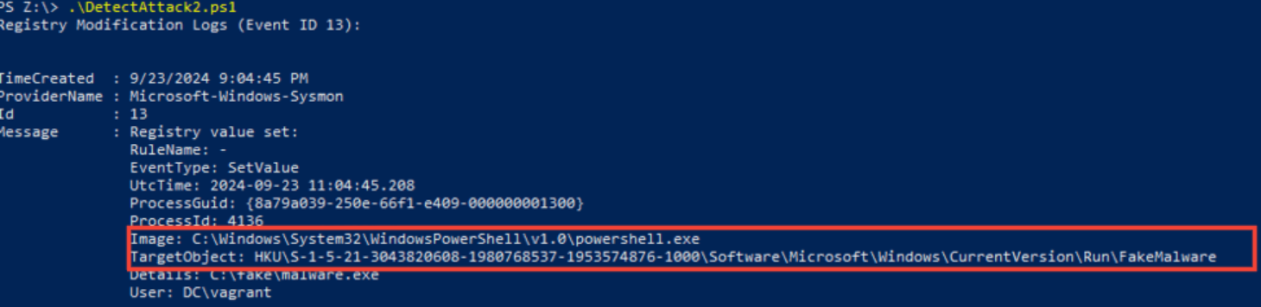
Attack 2: Detection with Sysmon
Now since the registry has been modified with the attack script, we need to detect this kind of attack. A PowerShell script named DetectAttack2.ps1 has been created to detect this attack. This will detect modifications to the text file using Sysmon relevant Event ID.
PS Command to Detect Attack2 PS Z:\> .\DetectAttack2.ps1
Sysmon effectively detected the registry modification used for persistence, logging the event under Event ID 13. This allows us to monitor unauthorized registry changes and track malware that modifies the registry for persistence.

Slide 11
Declaration of GEN AI usage
In this project, a Generative AI tool: CHATGPT was utilized to assist in writing and optimizing the PowerShell scripts for the file encryption and registry modification attack simulations.
CHATGPT helped fixed bugs and issues encountered along the road with Sysmon detection mechanisms. These scripts were further manually modified and tested to make sure they met the specific requirements of the assignment.

